Slide 1
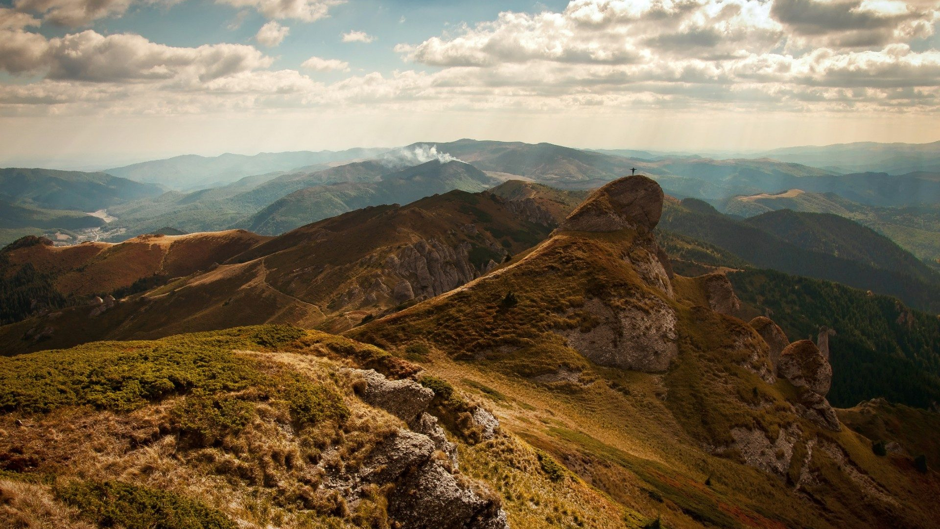

FRIENDS day: Big data
Typical day of a big data engineer
https://github.com/sergysta/bd-workshop-may.git
May 2019
by Sergei Stafeev

Slide 2

AGENDA
1
Big Data Overview
2
Case Study: Problem Overview
3
Case Study: Environment
4
Case Study: Narrowing Down

Slide 3
BIG DATA Overview

Slide 4
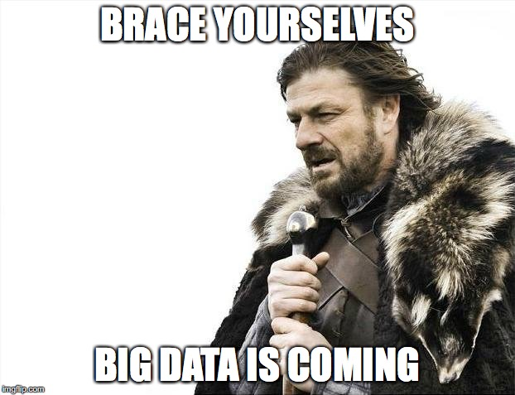

Slide 5
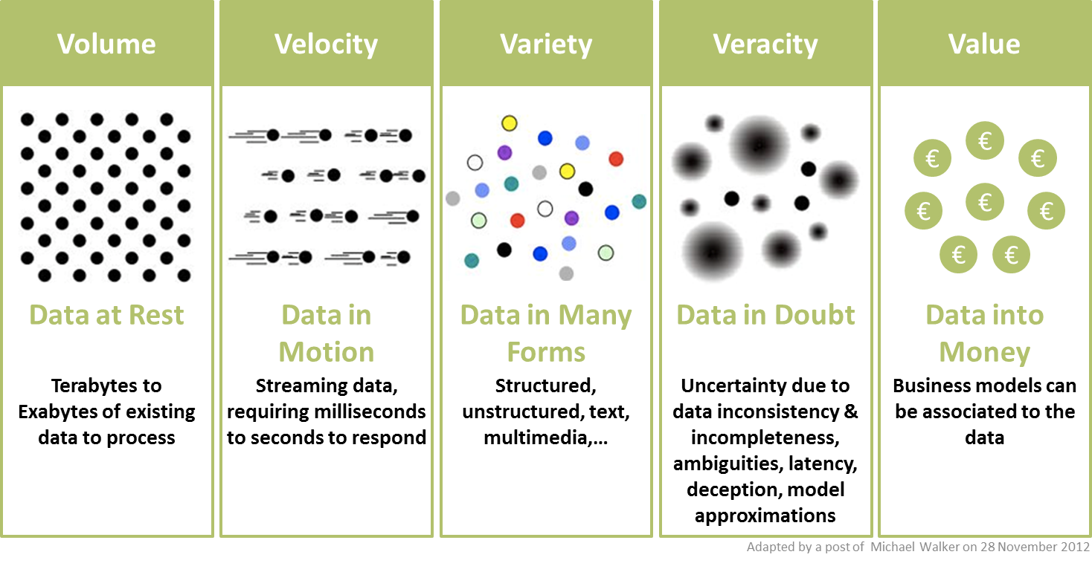
{Prerequisites

Slide 6
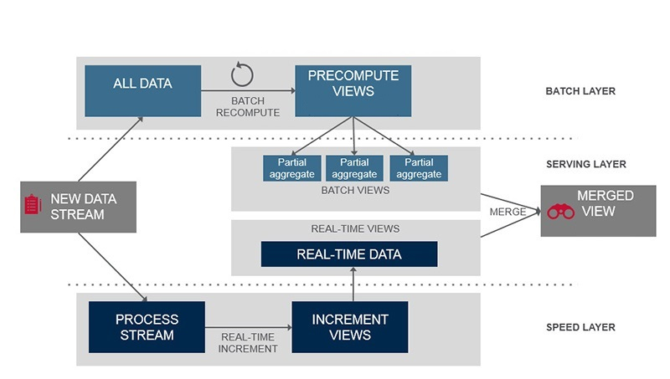
{Big Data approach: Lambda Architecture

Slide 7
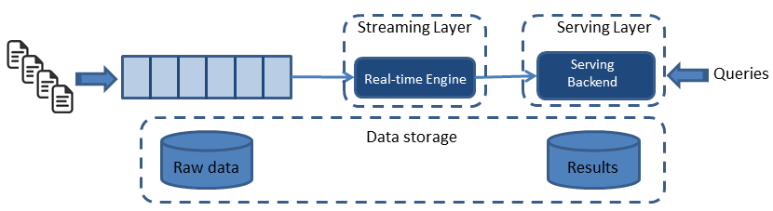
{Big Data approach: KAPPA Architecture

Slide 8
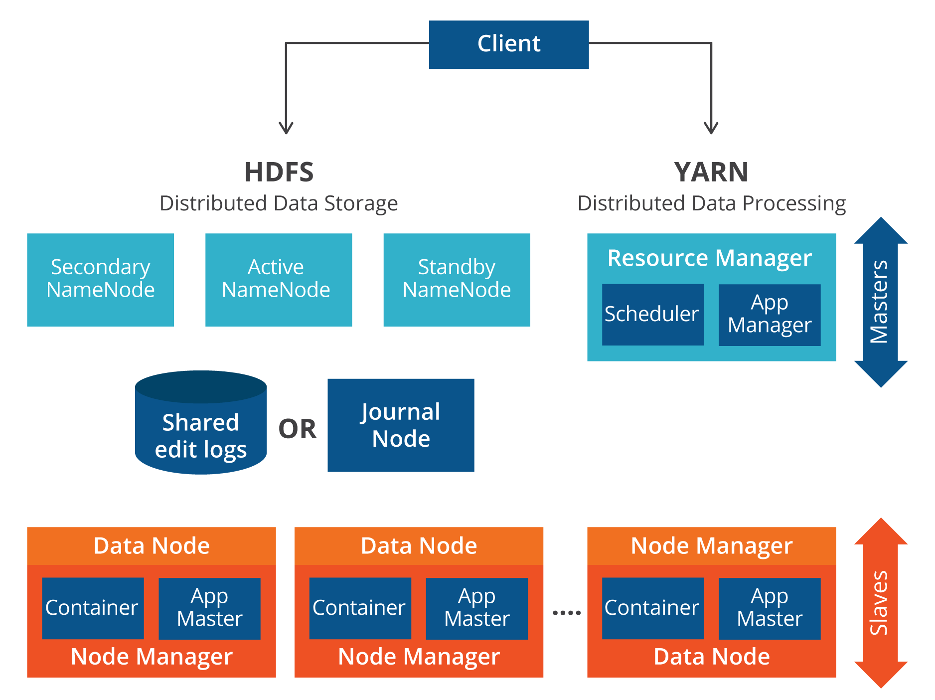
hadoop

Slide 9

hdfs

Slide 10
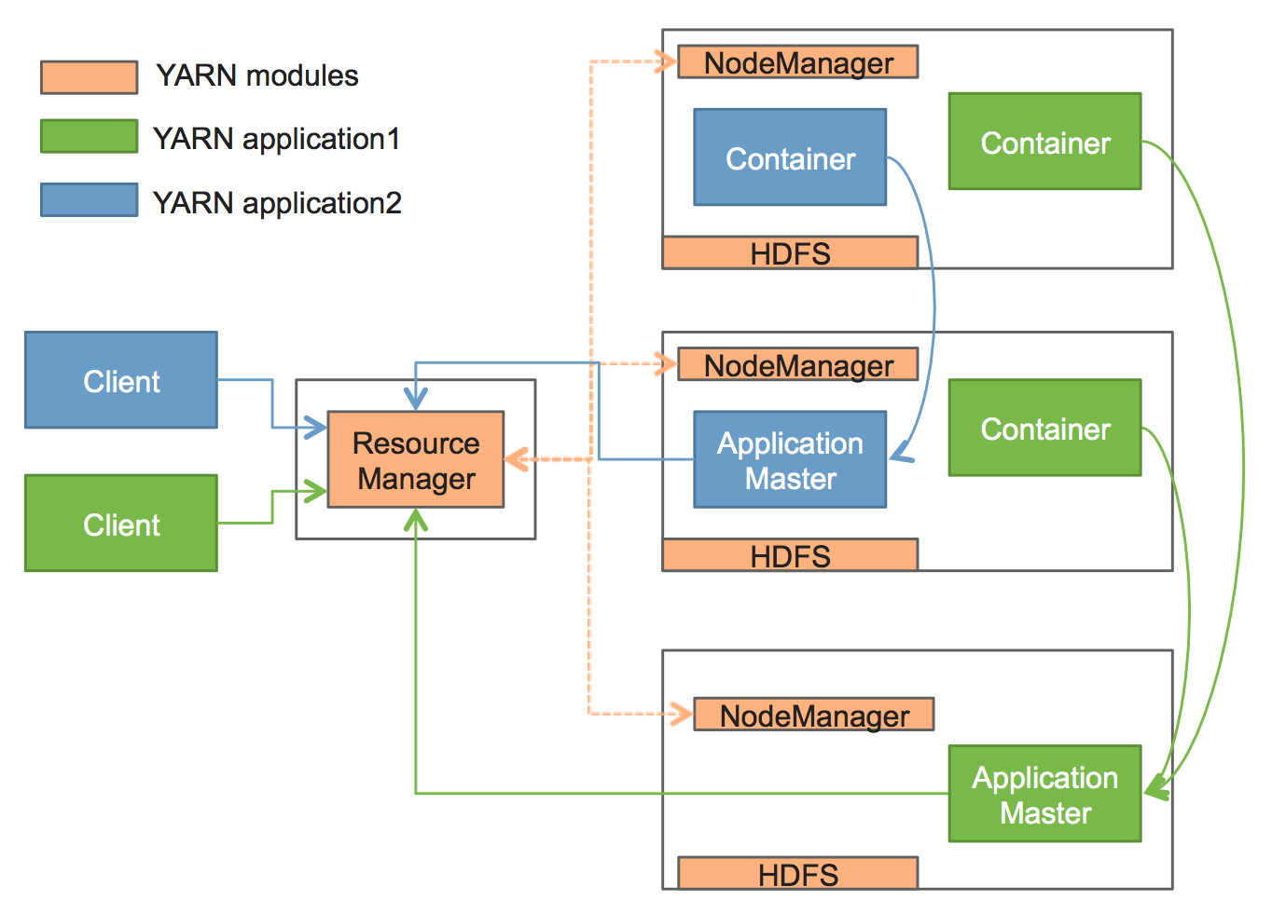
YARN

Slide 11
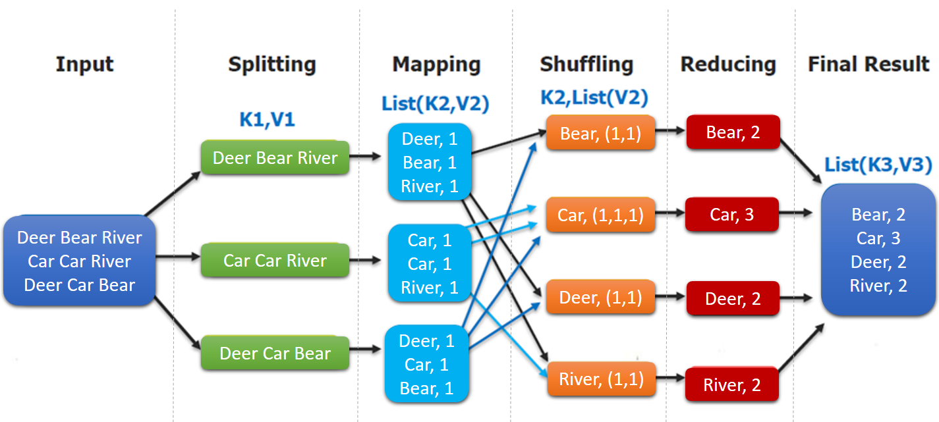
mapreduce

Slide 12
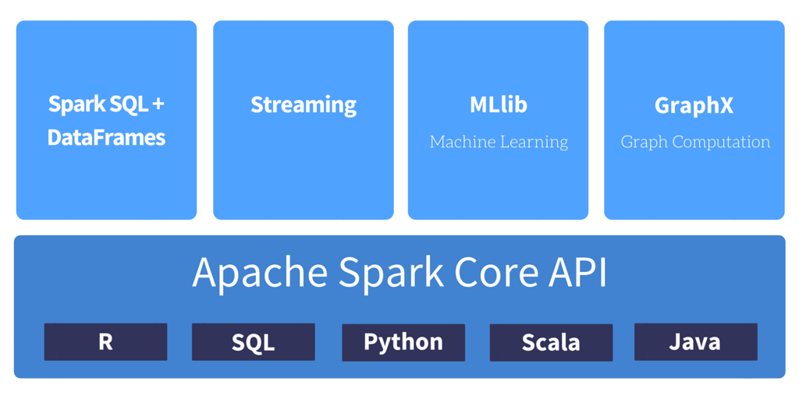
SPARK

Slide 13
Case study: PROBLEM OVERVIEW

Slide 14
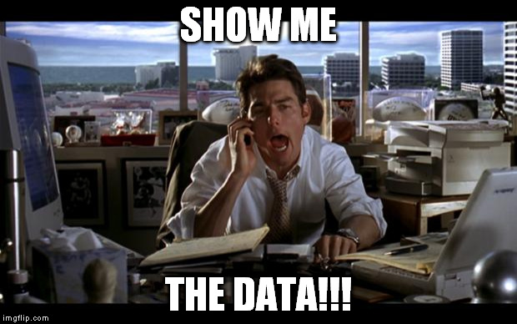


Slide 15
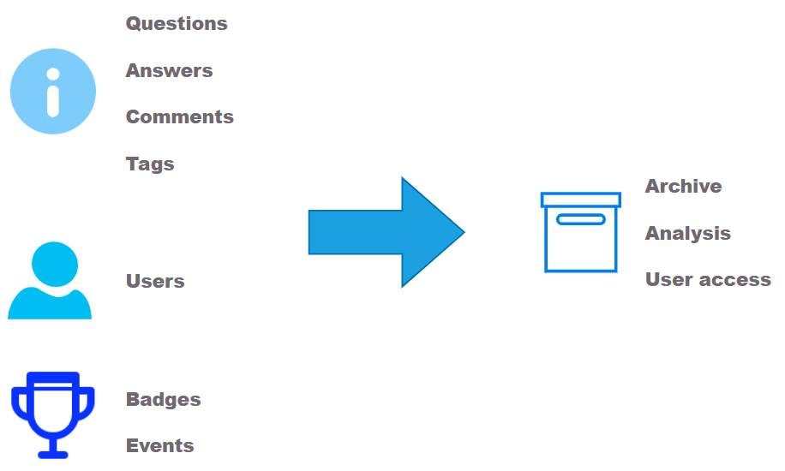
STACKOVERFLOW DATA PIPELINE

Slide 16

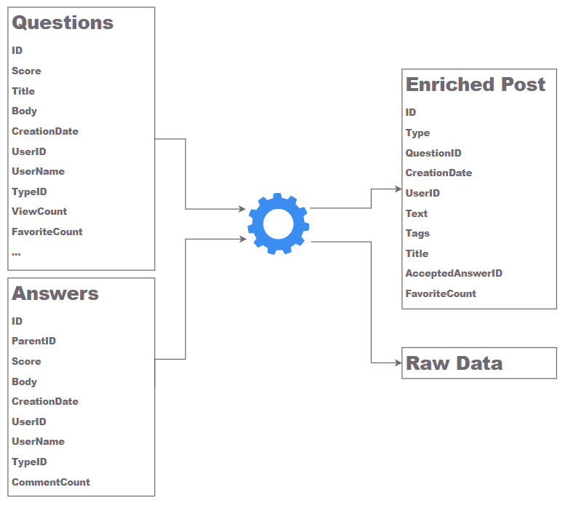

DATA SOURCES
Public dump
Stack Exchange API

Slide 17
Case study: Environment

Slide 18


Slide 19
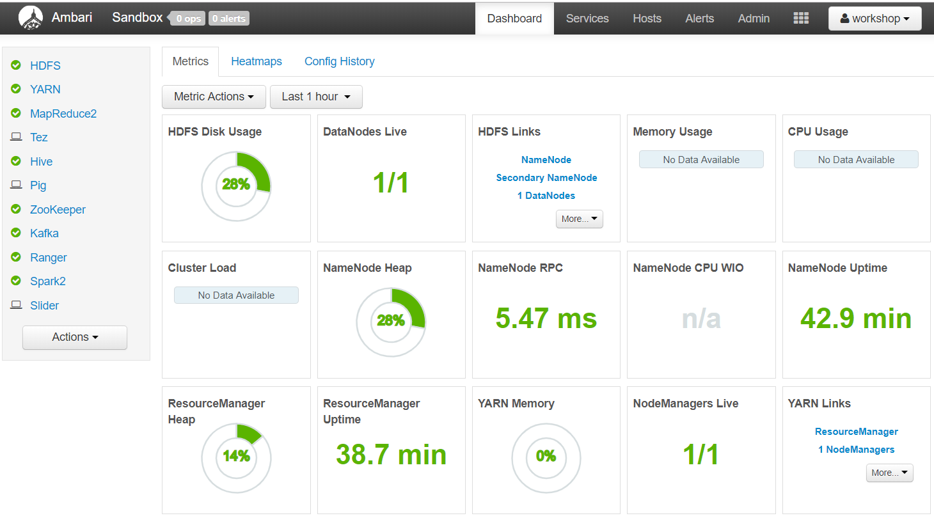
Hortonworks data platform

Slide 20
Case study: Narrowing down https://github.com/sergysta/bd-workshop-may.git

Slide 21
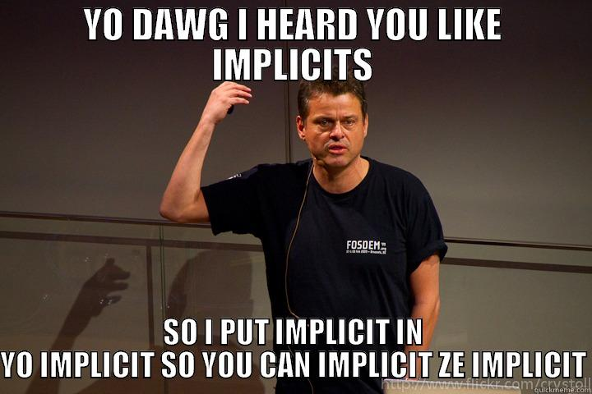

Slide 22
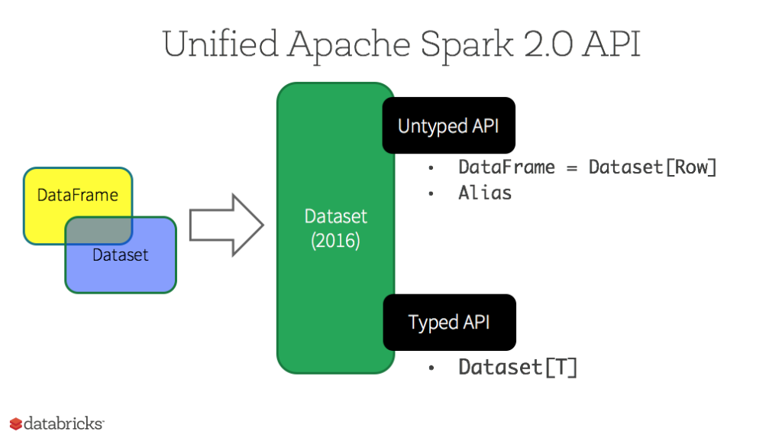
SPARK SQL

Slide 23

PROCESS STACKOVERFLOW DUMP

Slide 24
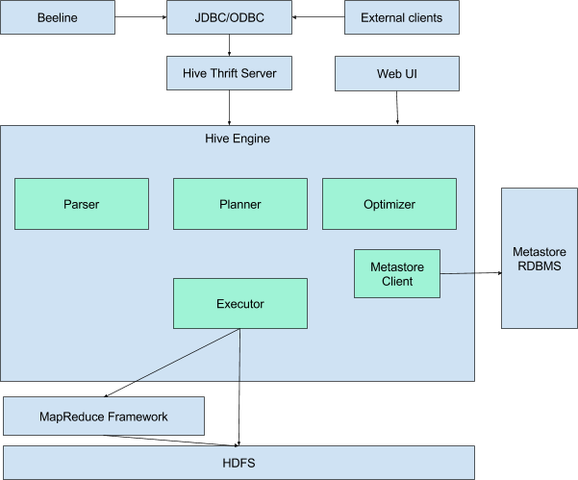
Hive

Slide 25

DATA Exploration

Slide 26
ELK: Elasticsearch, logstash, kibana

Slide 27
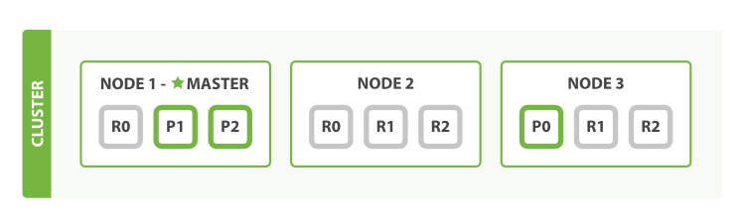
ELASTICSEARCH

Slide 28
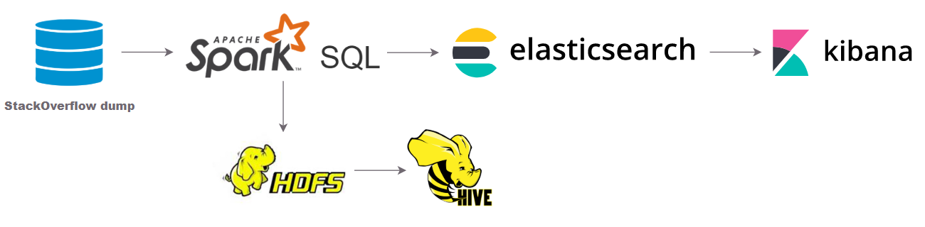
provide data for user interface

Slide 29
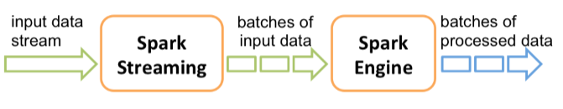
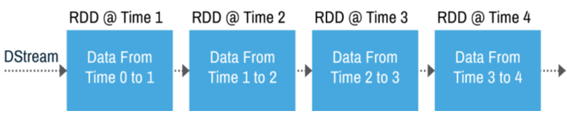
Spark streaming

Slide 30

Add streaming data processing

Slide 31
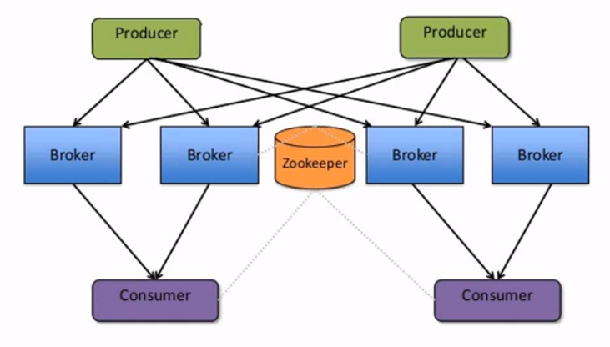
kafka

Slide 32
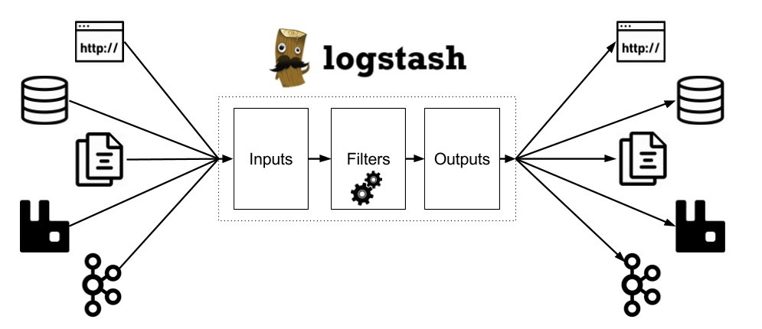
logstash

Slide 33
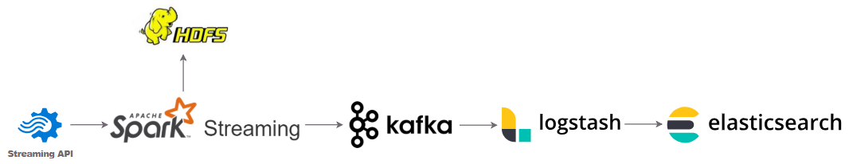
Provide streaming data for user interface

Slide 34
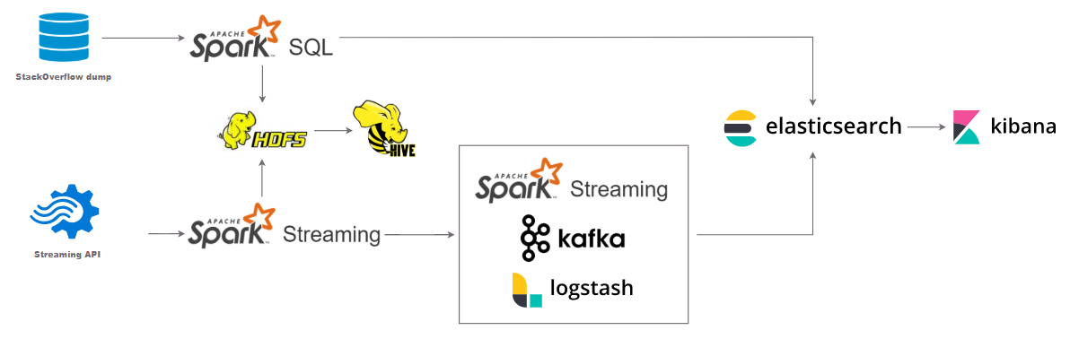
Solution overview

Slide 35
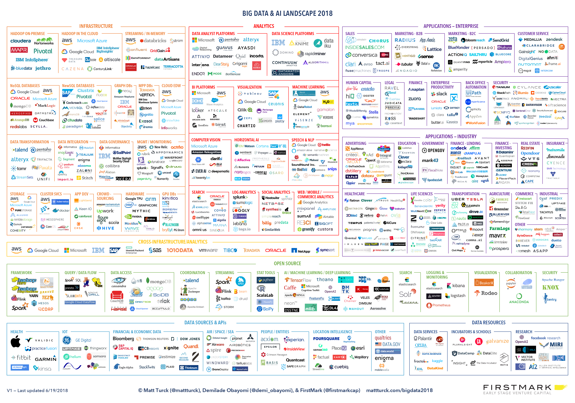
Never stop learning

Slide 36
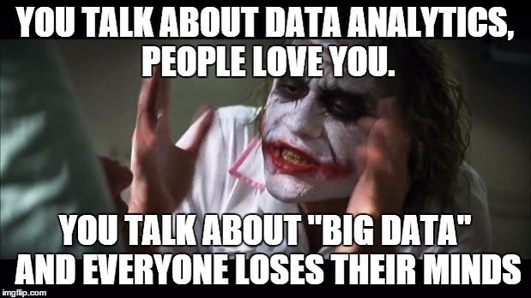

Slide 37

Thank You!

